Slide 1
AWS Architecture Icons
Release 15-2023.01.31

Slide 2
Release 15-2023.01.31: What’s New?
1/4
For the latest assets package and full resources, visit the AWS Architecture Center: https://aws.amazon.com/architecture/icons/
Guidelines
Guidance for Icons has been updated (slide 16)
Elements
Virtual private cloud (VPC) group has been updated (slide 26)
Diagonal arrows have been added (slide 28)
Analytics
AWS Glue for Ray / Resource Icon (slide 34)
AWS Glue Data Quality / Resource Icon (slide 34)
Data source connectors / Resource Icon (slide 34)
Data node / Resource Icon (slide 34)
Cluster Administrator node / Resource Icon (slide 34)
Analytics cont.
UltraWarm node / Resource Icon (slide 34)
Index / Resource Icon (slide 34)
Query Editor v2.0 / Resource Icon (slide 35)
Data sharing governance / Resource Icon (slide 35)
Auto-copy / Resource Icon (slide 35)
Streaming Ingestion / Resource Icon (slide 35)
Paginated Reports / Resource Icon (slide 35)
Amazon DataZone (slide 37)
Business data catalog / Resource Icon (slide 37)
Data portal / Resource Icon (slide 37)
Data projects / Resource Icon (slide 37)
AWS Clean Rooms (slide 37)
Application Integration
Scheduler / Resource Icon (slide 40)
Pipes / Resource Icon (slide 40)
Business Applications
AWS Wickr (slide 48)
AWS Supply Chain (slide 48)
Compute
M6in instance / Resource Icon (slide 54)
M6idn instance / Resource Icon (slide 54)
C6in instance / Resource Icon (slide 55)
C7gn instance / Resource Icon (slide 55)

Slide 3
Release 15-2023.01.31: What’s New?
2/4
For the latest assets package and full resources, visit the AWS Architecture Center: https://aws.amazon.com/architecture/icons/
Compute cont.
R7iz instance / Resource Icon (slide 56)
R6in instance / Resource Icon (slide 56)
R6idn instance / Resource Icon (slide 56)
Inf2 instance / Resource Icon (slide 57)
Hpc6id instance / Resource Icon (slide 58)
AWS SimSpace Weaver (slide 66)
Containers
EKS on Outposts / Resource Icon (slide 70)
ECS Service Connect / Resource Icon (slide 70)
Red Hat OpenShift Service on AWS (successor to Red Hat OpenShift) (slide 72)
Database
Trusted Language Extentions for PostgreSQL / Resource Icon (slides 77 and 79)
Amazon DocumentDB Elastic Clusters / Resource Icon (slide 77)
Blue/Green Deployments / Resource Icon (slide 79)
Optimized Writes / Resource Icon (slide 79)
Developer Tools
Amazon CodeCatalyst (slide 86)
AWS Application Composer (slide 86)
End User Computing
Amazon WorkSpaces Family (slide 88)
Amazon WorkSpaces / Resource Icon, previously a Service Icon (slide 88)
Amazon WorkSpaces Core / Resource Icon (slide 88)
Amazon WorkSpaces Web / Resource Icon, previously a Service Icon (slide 88)
Internet of Things
AWS IoT Device Tester / Resource Icon (slides 95, 97 and 98)
Device Advisor / Resource Icon (slide 96)
Device Location / Resource Icon (slide 96)

Slide 4
Release 15-2023.01.31: What’s New?
3/4
For the latest assets package and full resources, visit the AWS Architecture Center: https://aws.amazon.com/architecture/icons/
Machine Learning
Shadow Testing / Resource Icon (slide 104)
Geospatial ML / Resource Icon (slide 104)
Analyze Lending / Resource Icon (slide 105)
Amazon Omics (slide 111)
Management & Governance
Cross-account observability / Resource Icon (slide 113)
Data protection / Resource Icon (slide 113)
CloudTrail Lake / Resource Icon (slide 115)
Application Manager / Resource Icon (slide 116)
Incident Manager / Resource Icon, previously a Service Icon (slide 116)
Management & Governance cont.
Distributor / Resource Icon (slide 116)
AWS Service Management Connector (slide 120)
AWS Resource Explorer (slide 121)
Migration & Transfer
Agentless Collector / Resource Icon (slide 128)
Discovery Agent / Resource Icon (slide 128)
Migration Evaluator Collector / Resource Icon (slide 128)
AWS AS2 / Resource Icon (slide 128)
Discovery / Resource Icon (slide 128)
Networking & Content Delivery
Virtual private cloud (VPC) / Resource Icon (slide 132)
Transit gateway route table attachment / Resource Icon (slide 135)
Amazon VPC Lattice (slide 135)
AWS Verified Access (slide 135)
Security, Identity & Compliance
External Key Store (XKS) / Resource Icon (slide 146)
AWS Private Certificate Authority (slide 148)
Amazon Verified Permissions (slide 149)
Amazon Security Lake (slide 149)

Slide 5
Release 15-2023.01.31: What’s New?
4/4
For the latest assets package and full resources, visit the AWS Architecture Center: https://aws.amazon.com/architecture/icons/
Storage
Elastic Throughput / Resource Icon (slide 154)
AWS Elastic Disaster Recovery (successor to CloudEndure Disaster Recovery) (slide 154)
AWS Backup for AWS CloudFormation / Resource Icon (slide 157)
Legal hold / Resource Icon (slide 157)
AWS Backup Audit Manager / Resource Icon (slide 157)
AWS Backup Vault Lock / Resource Icon (slide 157)
S3 Multi-Region Access Points / Resource Icon (slide 158)
S3 Select / Resource Icon (slide 158)
S3 Object Lock / Resource Icon (slide 158)
S3 Batch Operations / Resource Icon (slide 158)
Storage cont.
Amazon File Cache (slide 159)
On-premises NFS linked datasets / Resource Icon (slide 159)
Hybrid NFS linked datasets / Resource Icon (slide 159)
S3 linked datasets / Resource Icon (slide 159)

Slide 6
Contents
Introduction
System
Guidelines
Examples
Elements

Slide 7
Introduction
About the deck and guidance for getting started

Slide 8
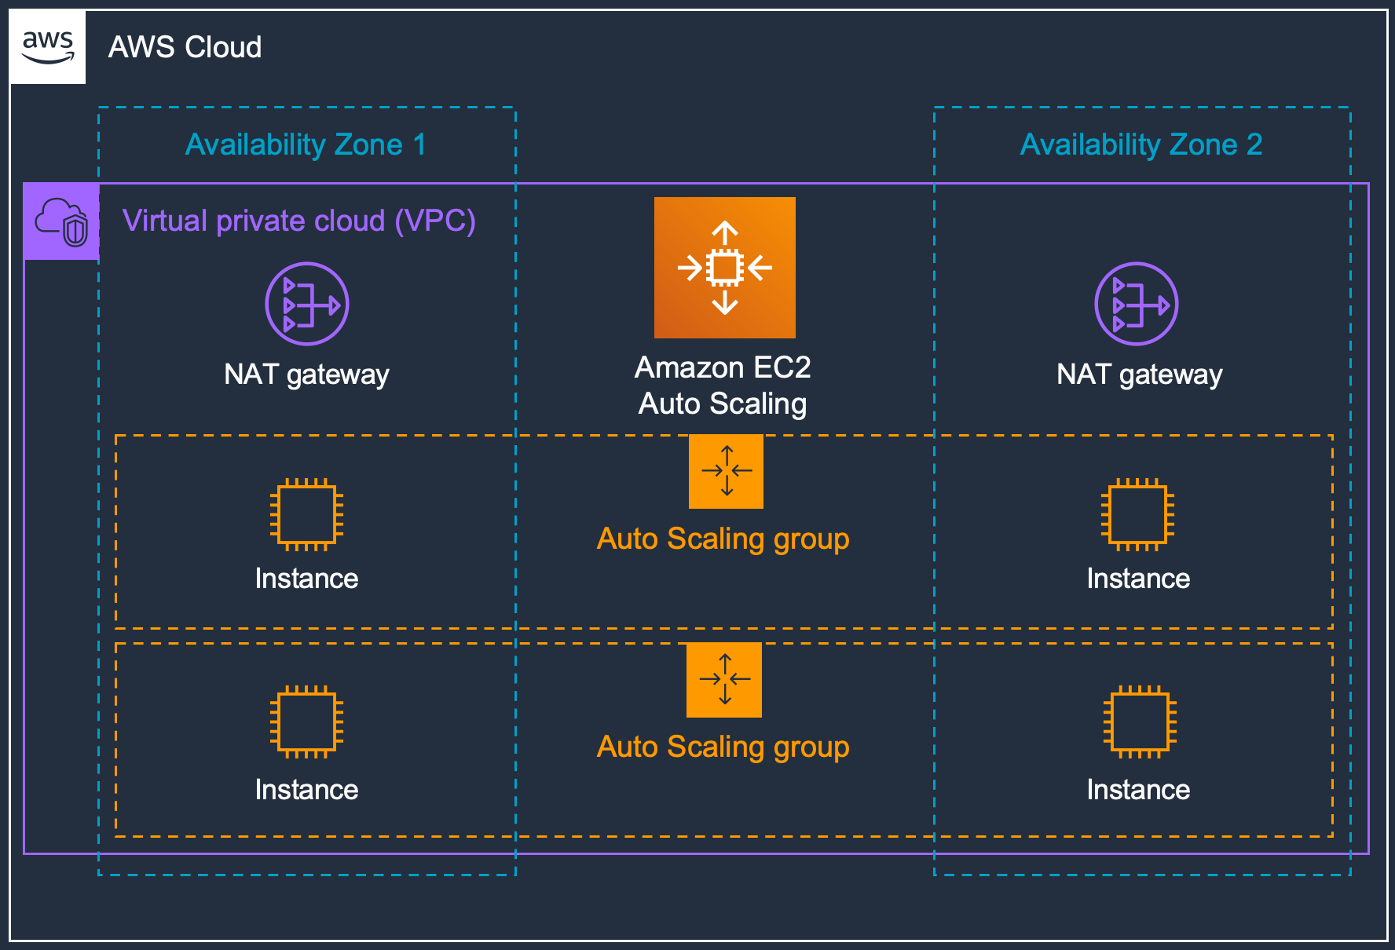
About AWS Architecture Icons
Architecture diagrams are a great way to communicate your design, deployment, and topology.
In this deck, you will find an official collection of AWS service icons, resource icons, additional assets and guidelines. These tools will help you build customer-focused and consistent AWS architecture diagrams.
Customers and partners can use AWS icons to create architecture diagrams. The icons are basic in design so that you can incorporate them directly into your whitepapers, presentations, datasheets, posters, or any technical material that you want.

Slide 9
Before You Begin:
1
Check for the latest deck update.
Download the latest deck from the AWS Architecture Center.
2
Read the guidelines.
For specific element guidance and best practices, see the guidelines.
3
When in doubt, see the examples.
For completed diagrams, go to the example pages. If you’re having trouble with a particular layout or object, use these as a template.

Slide 10
System
A complete overview of the design system

Slide 11





System Elements
AWS Cloud
Groups
Arrows
Service icons
Show the connections between multiple services or resources
Describe a flow of information or connect different parts of a diagram
Represent an AWS service
Resource icons
General resource icons
Represent an AWS service resource
Apply to resources and objects for multiple AWS services and categories

Slide 12





System Elements
Group icon
AWS Cloud
Availability Zone 1
Availability Zone 2
Nested groups
Virtual private cloud (VPC)
Service icon
NAT gateway
Amazon EC2 Auto Scaling
NAT gateway
Auto Scaling group
Instance
Instance
Auto Scaling group
Resource icon
Instance
Instance

Slide 13
Guidelines
Diagram and element guidance

Slide 14
Building a Diagram
Choose your deck style. The architecture deck is available for both light and dark backgrounds. Determine which best fits your need – light backgrounds tend to be used on the web, while dark backgrounds are used for in-person presentations or slide decks.
Start with the structure. Locate the groups (see slides 26-27) to use for the underlying structure of your diagram.
Add architecture service or resource icons. If you downloaded the asset package from the AWS Architecture Center, you can search for your icon from your folder. Simply drag & drop or insert wherever you are building your diagram.
Connect the steps. Use the preset arrows to connect your steps and describe a workflow.
Add any final touches. You can use numbers to help convey a specific order within your diagram (see slide 19).

Slide 15
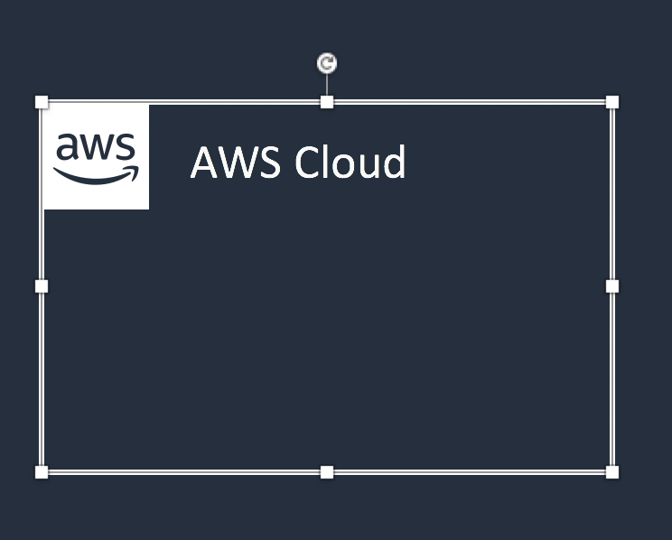


Groups
Each group consists of an icon and a label. Colors and lines help to differentiate groups to make it easier for the user to read a diagram at a glance. Some groups cross multiple groups, such as Auto Scaling, while others are meant to nest inside another, such as a VPC and subnets.
Resizing groups
Use the bottom-right corner of a group box to resize it.
Nested groups
When you have groups within groups, inner groups should have at least .05” buffer on all sides.
DO:
Use a generic group type if the presets do not suit your needs.
Add a custom group if needed, (see slide 27).
Virtual private cloud (VPC)
Public subnet
DON’T:
Create groups with nonapproved AWS icon(s).
Resize group icons.

Slide 16

Icons
Architecture service icons are designed to be used on both light and dark backgrounds. Please use the appropriate resource icons for the background type. You can find the correct icons in the assets package download or in the PowerPoint presentation.
Resizing icons
All icons in this deck are SVGs, allowing them to be scaled up or down only when used in presentations. To preserve icon integrity, be sure to hold down Shift while resizing.
For diagrams, use icons at their predefined size and do not resize.
DO:
Use icons at their predefined size, color and format in diagrams.
Scale icons as needed for use in presentations.
Hold down Shift while resizing.
DON’T:
Crop service icons.
Flip or rotate icons.
Change icon shapes.

Slide 17
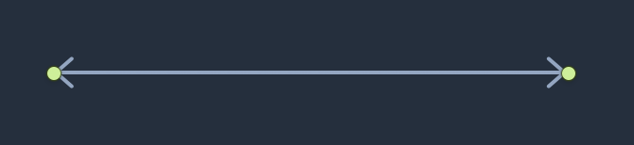
Arrows
Use arrows or lines to connect parts of a diagram or to show a workflow.
Use preset arrows
Copy the preset arrows into your diagram to maintain the correct formatting. To edit, click on the arrow and hold down Shift.
Create new arrows
Preset arrows use the “Open Arrow” in Size 4.
When in doubt, use the default
If the arrow shape that you need is not available in the sample arrows, use the default arrows.
DO:
Use the preset arrows provided in the Elements section.
Use straight lines and right angles to connect objects wherever possible.
In the instance where right angles are not possible, you may use a diagonal line as provided.
Default Arrow
+ Open Arrow
+ Size 4
DON’T:
Hold Shift
Use anything beside preset or default arrows.

Slide 18

Icon Labels
The icon and icon label are separated to allow for adjustment or abbreviation. The service icon label should be 12pt Arial and the resource icon label 11pt Arial to show hierarchy. Use the label color defined in this deck for dark background diagrams.
Name wrapping and line breaks
AWS service names must fit on no more than two lines. AWS or Amazon should always be accompanied by the service name. Lines should never break mid-word.
Short forms
To save space when using a service multiple times in a diagram, you may use the short service forms instead of the full name. For example, Amazon EC2, instead of Amazon Elastic Compute Cloud.
DO:
Break a line after the second word in the service name if necessary.
DON’T:
Amazon QuickSight
Amazon QuickSight
Amazon Quick- Sight
Use short forms without first mentioning the full service name somewhere in the document.
Duplicate short forms for different services, such as ELB for Elastic Beanstalk and Elastic Load Balancing.
Break a line in the middle of a word.
Amazon should be on the same line as the first word in the service name.
Lines should never break mid-word, and should fit on two lines max.

Slide 19
Numbered Callouts
Use numbered callouts to draw attention to steps in a process within a diagram (as shown on slide 22). Callouts are white with bold black type so that they stand out among the colored service and resource icons in the diagram. Consult with your team to see if you can use numbered callouts.
Large callouts
For a simple diagram, you can use large callouts.
Small callouts
For a complicated diagram, you can use small callouts.
DO:
Use callouts at their predefined size, color and format.
Order your numbers as linearly as possible, such as left to right, top to bottom, or clockwise.
Be as consistent as possible in placement of the callouts.
1
2
3
4
5
6
7
8
9
10
DON’T:
1
2
3
4
5
6
7
8
9
10
Mix callout sizes within the same diagram.
Change color or font size within the callout.
Use letters or other symbols.
Manually size or stretch the callout shape.
Create new callout shapes.

Slide 20
Examples
The system in action

Slide 21



Example: Git to S3 Webhooks
AWS Cloud
Amazon S3
SSH key bucket
Git push
Third-party Git repository
Git webhook
Git users
AWS KMS key
AWS Lambda
Amazon S3 output bucket

Slide 22


Example: Chef Automate Architecture on AWS
AWS Cloud
Availability Zone
Chef Knife uploads cookbooks.
Knife bootstraps and communicates with nodes.
Chef client processes run list.
Virtual private cloud (VPC)
Internet gateway
Public subnet
1
Chef Automate
3
2
Chef workstation (local Chef repo)
Chef node
10.0.0.0/19
10.0.0.0/16

Slide 23
Elements
Resources to use when building your diagram

Slide 24
Icon Categories
Click a category to jump to slide (must be in Presentation mode)
General Resources
Analytics
Application Integration
Blockchain
Business Applications
Cloud Financial Management
Compute
Contact Center
Containers
Customer Enablement
Database
Developer Tools
End User Computing
Front-End Web & Mobile
Games
Internet of Things
Machine Learning
Management & Governance
Media Services
Migration & Transfer
Networking & Content Delivery
Quantum Technologies
Robotics
Satellite
Security, Identity, & Compliance
Serverless
Storage
VR & AR

Slide 25
General Resources

Slide 26












Groups – Dark Backgrounds
1/5
*
AWS Cloud
AWS Cloud
Region
Availability Zone
Security group
Auto Scaling group
Virtual private cloud (VPC)
Private subnet
Public subnet
Server contents
Corporate
data center
EC2 instance contents
Spot Fleet
AWS account
AWS IoT Greengrass Deployment
AWS IoT Greengrass
Elastic Beanstalk container
AWS Step Functions workflow
Generic group
Generic group
*
In certain regions (i.e. China), AWS does not own the rights for the logo using the letters “AWS.” Per our guidelines, use the group with the AWS logo except in regions where the AWS logo cannot be used. You may use the group with the cloud icon in those cases.

Slide 27




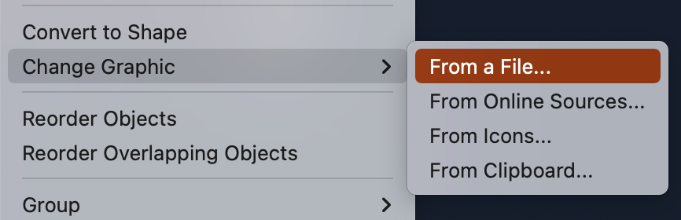
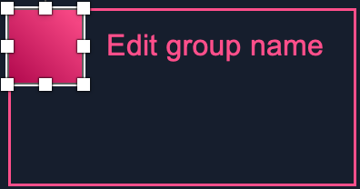



Create a Custom Group for a Service
2/5
Select a group with the category color where you find your service to start creating your custom group. All groups are fully editable.
Edit group name
Edit group name
Edit group name
Edit group name
Download the asset package. Go to the AWS Architecture Icons webpage and download the asset package to your desktop.
Begin customizing. In your chosen group, select the square icon and choose Change Graphic > From a File.
Find the service icon. Navigate to the architecture service icon DELIVERABLES folder in the asset package. Then find the appropriate category folder where the service appears.
Insert the service icon. In the Arch_32 folder, select the architecture service icon SVG file, then click Insert. Do not choose a PNG file, image quality will be degraded.
Analytics
Game Tech
Networking & Content Delivery
Serverless
Application Integration
Management & Governance
VR & AR
Cloud Financial Management
Internet of Things
Storage
End User Computing
Machine Learning
Migration & Transfer
Edit group name
Edit group name
Edit group name
Blockchain
Compute
Containers
Media Services
Quantum Technologies
Business Applications
Contact Center
Front-End Web & Mobile
Robotics
Security, Identity & Compliance
Customer Enablement
Database
Developer Tools
Satellite

Slide 28
Arrows – Dark Backgrounds
3/5

Slide 29






























General Icons – Dark Backgrounds
4/5
AWS Marketplace
Client
Disk
Forums
Generic database
Internet
Internet alt1
Internet alt2
Mobile client
Firewall
Email
Multimedia
Office building
SAML token
SSL padlock
Tape storage
User
Users
Toolkit
SDK
Gear
Traditional server
Servers
Source code
Document
Documents
Folder
Folders
Globe
Shield
Generic application

Slide 30







General Icons – Dark Backgrounds
5/5
AWS Marketplace
Chat
Camera
Alert
Magnifying Glass
AWS Management Console
Git repository
Question

Slide 31

Analytics
STANDARD CATEGORY ICON

Slide 32









Analytics
1/6
Amazon CloudSearch
Amazon EMR
AWS Lake Formation
Amazon Kinesis
Search documents
Cluster
HDFS
cluster
Data lake
EMR engine

Slide 33




Analytics
2/6
Amazon Kinesis Video Streams
Amazon Kinesis Data Streams
Amazon Kinesis Data Firehose
Amazon Kinesis Data Analytics

Slide 34













Analytics
3/6
AWS Glue
AWS Glue Elastic Views
Amazon Athena
Amazon OpenSearch Service
Crawler
AWS Glue Data Catalog
Data source connectors
Index
Data node
AWS Glue for Ray
AWS Glue Data Quality
UltraWarm node
Cluster Administrator node

Slide 35


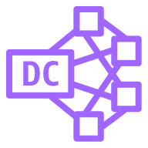
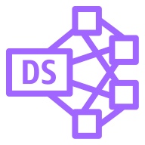
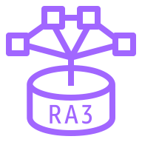






Analytics
4/6
Amazon Redshift
Amazon QuickSight
AWS Data Pipeline
Dense compute node
Dense storage node
RA3
Query Editor v2.0
Paginated Reports
Redshift ML
Data sharing governance
Auto-copy
Streaming Ingestion

Slide 36






Analytics
5/6
Amazon Managed Streaming for Apache Kafka
AWS Data Exchange
AWS Glue DataBrew
Amazon FinSpace
Amazon MSK Connect
AWS Data Exchange for APIs

Slide 37




Analytics
6/6
Amazon DataZone
AWS Clean Rooms
Business data catalog
Data portal
Data projects

Slide 38

Application Integration
STANDARD CATEGORY ICON

Slide 39



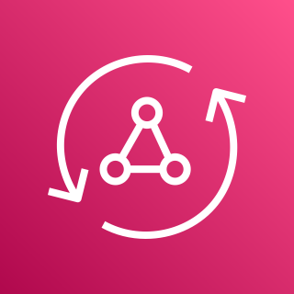






Application Integration
1/3
Amazon Simple Notification Service (Amazon SNS)
Amazon Simple Queue Service (Amazon SQS)
Amazon MQ
AWS AppSync
Email notification
Message
Broker
HTTP notification
Queue
Topic

Slide 40












Application Integration
2/3
AWS Step Functions
Amazon EventBridge
AWS Console Mobile Application
Event
Rule
SaaS
event bus
Default
event bus
Custom
event bus
Schema
Schema registry
Scheduler
Pipes

Slide 41





Application Integration
3/3
Amazon AppFlow
Amazon Managed Workflows for Apache Airflow
Amazon API Gateway
AWS Express Workflows
Endpoint

Slide 42

Blockchain
STANDARD CATEGORY ICON

Slide 43



Blockchain
1/1
Amazon Managed Blockchain
Amazon Quantum Ledger Database (Amazon QLDB)
Blockchain

Slide 44

Business Applications
STANDARD CATEGORY ICON

Slide 45




Business Applications
1/4
Alexa for Business
Amazon Chime
Amazon WorkMail
Amazon Honeycode

Slide 46






Business Applications
2/4
Amazon Connect
Amazon Pinpoint
Amazon Simple Email Service (Amazon SES)
Amazon WorkDocs
Journey
Email

Slide 47

Business Applications
3/4
Amazon Chime SDK
Amazon Chime Voice Connector
Amazon Pinpoint APIs
Amazon WorkDocs SDK

Slide 48


Business Applications
4/4
AWS Wickr
AWS Supply Chain

Slide 49

Cloud Financial Management
STANDARD CATEGORY ICON

Slide 50




Cloud Financial Management
1/2
AWS Budgets
AWS Cost & Usage Report
AWS Cost Explorer
Reserved Instance (RI) Reporting

Slide 51



Cloud Financial Management
2/2
Savings Plans
AWS Application Cost Profiler
AWS Billing Conductor

Slide 52

Compute
STANDARD CATEGORY ICON

Slide 53









Compute
1/14
Amazon Elastic Compute Cloud (Amazon EC2)
AMI
Auto scaling
Elastic IP address
Rescue
AWS Microservice Extractor for .NET
Instance
Instances
Spot Instance
Instance with CloudWatch
Habana Gaudi instance
Trainium instance

Slide 54



















Compute
2/14
Amazon Elastic Compute Cloud (Amazon EC2)
General-purpose instances
Mac instance
M1 Mac instance
T4g instance
T3 instance
T3a instance
T2 instance
M6g instance
M6gd instance
M6i instance
M6in instance
M6idn instance
M6a instance
M5 instance
M5a instance
M5d instance
M5n instance
M5dn instance
M5zn instance
M4 instance
A1 instance

Slide 55













Compute
3/14
Amazon Elastic Compute Cloud (Amazon EC2)
Compute-optimized instances
C7gn instance
C7g instance
C6g instance
C6gd instance
C6gn instance
C6i instance
C6in instance
C6a instance
C5 instance
C5d instance
C5a instance
C5ad instance
C5n instance
C4 instance

Slide 56














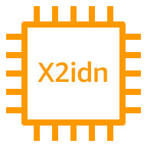





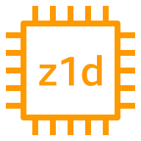
Compute
4/14
Amazon Elastic Compute Cloud (Amazon EC2)
Memory-optimized instances
R7iz instance
R6in instance
R6idn instance
R6a instance
R6g instance
R6i instance
R5 instance
R5a instance
R5ad instance
R5gd instance
R5b instance
R5n instance
R4 instance
X2gd instance
X2idn instance
X2iedn instance
X2iezn instance
X1e instance
X1 instance
High Memory instance
z1d instance

Slide 57

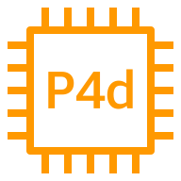














Compute
5/14
Amazon Elastic Compute Cloud (Amazon EC2)
Accelerated-computing instances
P4 instance
P4d instance
P4de instance
P3 instance
P3dn instance
P2 instance
DL1 instance
Trn1 instance
Inf2 instance
Inf1 instance
G5 instance
G5g instance
G4dn instance
G4ad instance
G3 instance
F1 instance
VT1 instance

Slide 58













Compute
6/14
Amazon Elastic Compute Cloud (Amazon EC2)
Storage-optimized instances
Im4gn instance
Is4gen instance
I4i instance
I3 instance
I3en instance
I2 instance
D2 instance
D3 instance
D3en instance
H1 instance
DB instance
HPC-optimized instances
Hpc6id instance
Hpc6a instance

Slide 59






Compute
7/14
AWS Elastic Beanstalk
AWS Lambda
Amazon Lightsail
Amazon EC2 Auto Scaling
Deployment
Lambda function
Application

Slide 60




Compute
8/14
AWS Outposts family
AWS Outposts rack
AWS Outposts servers
AWS Serverless Application Repository

Slide 61




Compute
9/14
VMware Cloud on AWS
AWS Thinkbox Deadline
AWS Thinkbox XMesh
AWS Thinkbox Frost

Slide 62




Compute
10/14
AWS Thinkbox Krakatoa
AWS Thinkbox Sequoia
AWS Thinkbox Stoke
AWS Wavelength

Slide 63




Compute
11/14
AWS Compute Optimizer
AWS Local Zones
Amazon EC2 Image Builder
Bottlerocket

Slide 64




Compute
12/14
AWS ParallelCluster
NICE DCV
Elastic Fabric Adapter
AWS Nitro Enclaves

Slide 65




Compute
13/14
AWS App Runner
NICE EnginFrame
Amazon Genomics CLI
AWS Batch

Slide 66

Compute
14/14
AWS SimSpace Weaver

Slide 67

Contact Center
CATEGORY ICON
COMING Q2-2023

Slide 68
Contact Center
1/1
Amazon Connect

Slide 69

Containers
STANDARD CATEGORY ICON

Slide 70














Containers
1/3
Amazon Elastic Kubernetes Service (Amazon EKS)
Amazon Elastic Container Registry (Amazon ECR)
Amazon Elastic Container Service (Amazon ECS)
Amazon ECS Anywhere
EKS on Outposts
Registry
Container 1
Container 2
Image
Container 3
Task
Service
ECS Service Connect
Copilot CLI

Slide 71




Containers
2/3
Amazon EKS Anywhere
Amazon EKS Cloud
Amazon EKS Distro
AWS Fargate

Slide 72

Containers
3/3
Red Hat OpenShift Service on AWS (ROSA)
(successor to Red Hat OpenShift)

Slide 73

Customer Enablement
STANDARD CATEGORY ICON

Slide 74




Customer Enablement
1/2
AWS IQ
AWS Managed Services
AWS Professional Services
AWS Support

Slide 75



Customer Enablement
2/2
AWS Training and Certification
AWS Activate
AWS re:Post

Slide 76

Database
STANDARD CATEGORY ICON

Slide 77

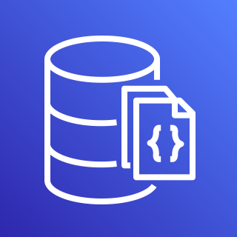









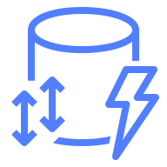


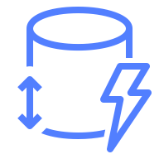
Database
1/5
Amazon Aurora
Amazon DocumentDB (with MongoDB compatibility)
Amazon DynamoDB
Trusted Language Extensions for PostgreSQL
Amazon DocumentDB Elastic Clusters
Attribute
Items
Amazon DynamoDB Accelerator (DAX)
Stream
Item
Table
Standard Access table class
Attributes
Global secondary
index
Standard–Infrequent Access table class

Slide 78



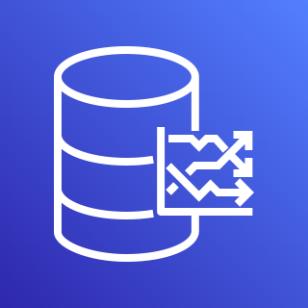

Database
2/5
Amazon Keyspaces (for Apache Cassandra)
AWS Database Migration Service (AWS DMS)
Amazon Neptune
Amazon Timestream
Database migration workflow or job

Slide 79







Database
3/5
Amazon Relational Database Service (Amazon RDS)
Amazon RDS on VMware
Amazon MemoryDB for Redis
Multi-AZ
Multi-AZ DB cluster
Blue/Green Deployments
Optimized Writes
Trusted Language Extensions for PostgreSQL

Slide 80




Database
4/5
Amazon ElastiCache
Cache node
ElastiCache
for Redis
ElastiCache for Memcached

Slide 81










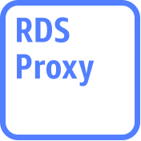
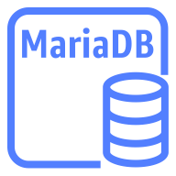



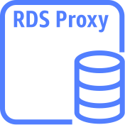
Database
5/5
Amazon Aurora instance
Amazon Aurora instance alternate
Amazon RDS instance
Amazon RDS
instance alternate
MySQL
instance
MySQL
instance alternate
Oracle
instance
Oracle
instance alternate
PostgreSQL instance
PostgreSQL
instance alternate
PIOPS instance
Amazon RDS
proxy instance alternate
MariaDB instance
MariaDB instance alternate
SQL Server
instance
SQL Server
instance alternate
Amazon RDS
proxy instance

Slide 82

Developer Tools
STANDARD CATEGORY ICON

Slide 83





Developer Tools
1/4
AWS Cloud9
AWS CodeBuild
AWS CodeCommit
AWS CodeDeploy
Cloud9

Slide 84




Developer Tools
2/4
AWS CodePipeline
AWS CodeStar
AWS Command Line Interface (AWS CLI)
AWS Tools and SDKs

Slide 85

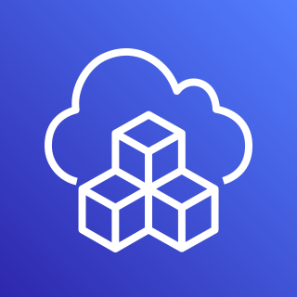


Developer Tools
3/4
AWS X-Ray
AWS Cloud Development Kit (AWS CDK)
AWS CodeArtifact
AWS CloudShell

Slide 86




Developer Tools
4/4
Amazon Corretto
AWS Cloud Control API
Amazon CodeCatalyst
AWS Application Composer

Slide 87

End User Computing
STANDARD CATEGORY ICON

Slide 88






End User Computing
1/1
Amazon AppStream 2.0
Amazon WorkSpaces Family
Amazon WorkLink
Amazon WorkSpaces
Amazon WorkSpaces Core
Amazon WorkSpaces Web

Slide 89

Front-End Web & Mobile
STANDARD CATEGORY ICON

Slide 90









Front-End Web & Mobile
1/1
AWS Amplify
AWS Device Farm
Amazon Location Service
AWS Amplify Studio
Track
Place
Map
Geofence
Routes

Slide 91

Games
STANDARD CATEGORY ICON

Slide 92




Games
1/2
Amazon GameLift
AWS GameKit
Amazon GameSparks
Open 3D Engine

Slide 93

Games
2/2
Amazon Lumberyard

Slide 94

Internet of Things
STANDARD CATEGORY ICON

Slide 95










Internet of Things
1/7
FreeRTOS
AWS IoT 1-Click
AWS IoT Analytics
AWS IoT Button
AWS IoT Device Tester
Channel
Dataset
Pipeline
Notebook
Data store

Slide 96








Internet of Things
2/7
AWS IoT Core
AWS IoT Device Defender
AWS IoT Device Management
AWS IoT Events
Device Advisor
IoT device jobs
Fleet Hub
Device Location

Slide 97



















Internet of Things
3/7
AWS IoT Greengrass
AWS IoT SiteWise
AWS IoT Things Graph
Connector
Stream manager
Artifact
Component
Asset model
Asset
Component machine learning
Component nucleus
Component private
Component public
Properties
Data streams
Interprocess communication
Protocol
Recipe
AWS IoT Device Tester
Asset hierarchy

Slide 98




Internet of Things
4/7
AWS IoT ExpressLink
AWS IoT TwinMaker
AWS IoT RoboRunner
AWS IoT FleetWise
AWS IoT Device Tester

Slide 99

Internet of Things
5/7
AWS IoT EduKit

Slide 100



























Internet of Things
6/7
IoT action
IoT actuator
IoT certificate
IoT desired state
IoT hardware board
IoT HTTP protocol
IoT HTTP/2 protocol
IoT MQTT protocol
IoT policy
IoT reported state
IoT rule
IoT sensor
IoT servo
IoT shadow
IoT simulator
IoT topic
Alexa skill
Alexa Voice Service
Alexa-enabled device
Echo
Fire TV
Fire TV Stick
Lambda function
Over-the-air update
Device gateway
AWS IoT Core for LoRaWAN protocol
LoRaWAN protocol

Slide 101


























Internet of Things
7/7
IoT thing bank
IoT thing bicycle
IoT thing camera
IoT thing car
IoT thing cart
IoT thing coffee pot
IoT thing door lock
IoT thing factory
IoT thing generic
IoT thing house
IoT thing lightbulb
IoT thing travel
IoT thing medical emergency
IoT thing police emergency
IoT thing utility
IoT thing windfarm
IoT thing humidity sensor
IoT thing vibration sensor
IoT thing temperature sensor
IoT thing temperature & humidity sensor
IoT thing temperature & vibration sensor
IoT thing relay
IoT thing stack light
IoT thing FreeRTOS device
IoT thing industrial PC
IoT thing PLC

Slide 102

Machine Learning
STANDARD CATEGORY ICON

Slide 103




Machine Learning
1/9
Amazon Comprehend
Amazon Elastic Inference
Amazon Forecast
Amazon Lex

Slide 104












Machine Learning
2/9
Amazon Personalize
Amazon Polly
Amazon Rekognition
Amazon SageMaker
Amazon Rekognition image
Notebook
Canvas
Amazon Rekognition video
Model
Train
Shadow Testing
Geospatial ML

Slide 105





Machine Learning
3/9
Amazon SageMaker Ground Truth
Amazon Textract
Amazon Transcribe
Amazon Translate
Analyze Lending

Slide 106




Machine Learning
4/9
AWS Deep Learning AMIs
AWS Deep Learning Containers
AWS DeepLens
AWS DeepRacer

Slide 107



Machine Learning
5/9
Apache MXNet on AWS
TensorFlow on AWS
AWS DeepComposer
Amazon Augmented AI (Amazon A2I)

Slide 108




Machine Learning
6/9
Amazon Fraud Detector
Amazon Kendra
Amazon CodeGuru
TorchServe

Slide 109




Machine Learning
7/9
Amazon Lookout for Equipment
Amazon Lookout for Metrics
Amazon Lookout for Vision
Amazon Monitron

Slide 110





Machine Learning
8/9
Amazon DevOps Guru
Amazon HealthLake
AWS Panorama
AWS Neuron
Insights

Slide 111




Machine Learning
9/9
Amazon SageMaker Studio Lab
Amazon Comprehend Medical
Amazon CodeWhisperer
Amazon Omics

Slide 112

Management & Governance
STANDARD CATEGORY ICON

Slide 113

















Management & Governance
1/9
Amazon CloudWatch
AWS Auto Scaling
AWS CloudFormation
Alarm
Rule
RUM
Cross-account observability
Change set
Stack
Event (time-based)
Event (event-based)
Evidently
Data protection
Template
Logs
Synthetics
Metrics Insights

Slide 114






Management & Governance
2/9
AWS Application Auto Scaling
AWS Config
AWS License Manager
AWS Personal Health Dashboard
License blending
Application discovery

Slide 115












Management & Governance
3/9
AWS Management Console
AWS OpsWorks
AWS CloudTrail
Apps
Instances
Monitoring
CloudTrail Lake
Permissions
Deployments
Layers
Resources
Stack2

Slide 116


















Management & Governance
4/9
AWS Service Catalog
AWS Systems Manager
Automation
Documents
Patch Manager
Parameter Store
OpsCenter
Maintenance Windows
Inventory
State Manager
Run Command
Incident Manager
Session Manager
Change Manager
Change Calendar
Compliance
Application Manager
Distributor

Slide 117








Management & Governance
5/9
AWS Trusted Advisor
AWS Well-Architected Tool
AWS Control Tower
Checklist
cost
Checklist
performance
Checklist
security
Checklist
fault tolerant
Checklist

Slide 118
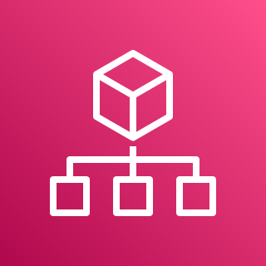






Management & Governance
6/9
AWS Organizations
AWS AppConfig
AWS Chatbot
AWS Backint Agent
Account
Organizational unit
Management account

Slide 119




Management & Governance
7/9
AWS Fault Injection Simulator
Amazon Managed Grafana
Amazon Managed Service for Prometheus
AWS Distro for OpenTelemetry

Slide 120




Management & Governance
8/9
AWS Proton
AWS Launch Wizard
AWS Resilience Hub
AWS Service Management Connector (SMC)

Slide 121

Management & Governance
9/9
AWS Resource Explorer

Slide 122

Media Services
STANDARD CATEGORY ICON

Slide 123





Media Services
1/4
Amazon Elastic Transcoder
Amazon Kinesis Video Streams
AWS Elemental MediaConnect
AWS Elemental MediaConvert
AWS Cloud Digital Interface

Slide 124




Media Services
2/4
AWS Elemental MediaLive
AWS Elemental MediaPackage
AWS Elemental MediaStore
AWS Elemental MediaTailor

Slide 125

Media Services
3/4
AWS Elemental Conductor
AWS Elemental Delta
AWS Elemental Live
AWS Elemental Server

Slide 126



Media Services
4/4
AWS Elemental Appliances & Software
Amazon Interactive Video Service
AWS Elemental Link
Amazon Nimble Studio

Slide 127

Migration & Transfer
STANDARD CATEGORY ICON

Slide 128











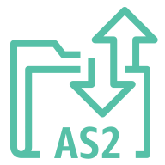




Migration & Transfer
1/2
AWS Application Discovery Service
AWS Transfer Family
AWS DataSync
AWS Migration Hub
Agentless Collector
AWS FTPS
AWS SFTP
Agent
Refactor Spaces services
Discovery Agent
AWS FTP
AWS AS2
Discovery
Refactor Spaces applications
Migration Evaluator Collector
Refactor Spaces environments

Slide 129









Migration & Transfer
2/2
AWS Server Migration Service (AWS SMS)
AWS Application Migration Service
AWS Migration Evaluator
AWS Mainframe Modernization
Analyzer
Compiler
Converter
Runtime
Developer

Slide 130

Networking & Content Delivery
STANDARD CATEGORY ICON

Slide 131







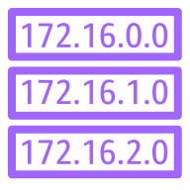








Networking & Content Delivery
1/5
AWS Transit Gateway
Amazon CloudFront
Amazon Route 53
Attachment
Download distribution
Edge location
Hosted zone
Route table
Readiness checks
Streaming distribution
Functions
Resolver
Resolver DNS firewall
Routing controls
Resolver query logging
Application recovery controller

Slide 132

















Networking & Content Delivery
2/5
Amazon Virtual Private Cloud (Amazon VPC)
Customer gateway
Internet gateway
VPN gateway
Flow logs
Endpoints
Router
Traffic mirroring
NAT gateway
Elastic network interface
Elastic network adapter
Network access control list
VPN connection
Peering connection
Reachability Analyzer
Carrier gateway
Network Access Analyzer
Virtual private cloud (VPC)

Slide 133













Networking & Content Delivery
3/5
AWS App Mesh
AWS Cloud Map
AWS Direct Connect
AWS Global Accelerator
Mesh
Virtual
gateway
Service
Gateway
Virtual node
Virtual router
Namespace
Virtual service
Resource

Slide 134








Networking & Content Delivery
4/5
AWS Client VPN
AWS Site-to-Site VPN
Elastic Load Balancing
AWS PrivateLink
Application Load Balancer
Network Load Balancer
Classic Load Balancer
Gateway Load Balancer

Slide 135







Networking & Content Delivery
5/5
AWS Cloud WAN
AWS Private 5G
Amazon VPC Lattice
AWS Verified Access
Segment network
Core network edge
Transit gateway route table attachment

Slide 136

Quantum Technologies
STANDARD CATEGORY ICON

Slide 137










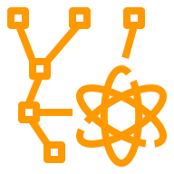



Quantum Technologies
1/1
Amazon Braket
Chandelier
Chip
QPU
Simulator
Simulator 1
Simulator 2
Simulator 3
Simulator 4
State vector
Tensor network
Noise simulator
Embedded simulator
Managed simulator

Slide 138

Robotics
STANDARD CATEGORY ICON

Slide 139





Robotics
1/1
AWS RoboMaker
Cloud extensions ROS
Development environment
Fleet
management
Simulation

Slide 140

Satellite
STANDARD CATEGORY ICON

Slide 141

Satellite
1/1
AWS Ground Station

Slide 142

Security, Identity, & Compliance
STANDARD CATEGORY ICON

Slide 143





Security, Identity, & Compliance
1/7
Amazon Cloud Directory
Amazon Cognito
Amazon GuardDuty
Amazon Inspector
Agent

Slide 144





Security, Identity, & Compliance
2/7
Amazon Macie
AWS Artifact
AWS Certificate Manager (ACM)
AWS CloudHSM
Certificate authority

Slide 145









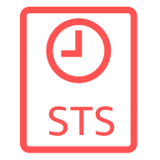







Security, Identity, & Compliance
3/7
AWS Directory Service
AWS Firewall Manager
AWS Identity and Access Management (IAM)
Simple AD
Add-on
Permissions
MFA token
Role
AD Connector
AWS STS
AWS STS alternate
Long-term security
credential
IAM Access Analyzer
AWS Managed Microsoft AD
Encrypted data
Data encryption key
Temporary security credential
IAM Roles Anywhere

Slide 146







Security, Identity, & Compliance
4/7
AWS Key Management Service (AWS KMS)
AWS Secrets Manager
AWS Security Hub
AWS Shield
External Key Store (XKS)
Finding
AWS Shield Advanced

Slide 147











Security, Identity, & Compliance
5/7
AWS IAM Identity Center
AWS WAF
Amazon Detective
AWS Resource
Access Manager
Rule
Managed rule
Filtering rule
Labels
Bot
Bad bot
Bot control

Slide 148





Security, Identity, & Compliance
6/7
AWS Audit Manager
AWS Network Firewall
AWS Signer
AWS Private Certificate Authority
Endpoints

Slide 149


Security, Identity, & Compliance
7/7
Amazon Verified Permissions
Amazon Security Lake

Slide 150

Serverless
STANDARD CATEGORY ICON

Slide 151
Serverless
1/1
Serverless is a way to describe the services that enable you to build and run applications without thinking about servers. AWS has serverless services for all layers of your stack. In many public forums, like our marketing website, we list these services under the Serverless heading because it improves discoverability.
When it comes to building an architecture diagram, it’s more intuitive to use a functional categorization. Please find the architecture icon for each serverless service in its functional category. You can use the serverless category icon to describe serverless applications or architectures.
To view the full list of Serverless Applications and learn more follow the link below:
Serverless on AWS »

Slide 152

Storage
STANDARD CATEGORY ICON

Slide 153
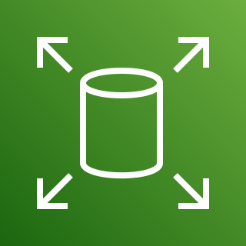














Storage
1/7
Amazon Elastic Block Store (Amazon EBS)
AWS Storage Gateway
Snapshot
Multiple volumes
Amazon Data Lifecycle Manager
Noncached
volume
Cached
volume
Amazon FSx
File Gateway
Volume
Volume gp3
Virtual tape
library
Tape
Gateway
Amazon S3
File Gateway
Volume
Gateway
File
gateway

Slide 154










Storage
2/7
Amazon Elastic File System (Amazon EFS)
AWS Elastic Disaster Recovery (AWS DRS)
(successor to CloudEndure DR)
Amazon FSx
File system
Standard
Standard–Infrequent Access
Intelligent-Tiering
One Zone
One Zone Infrequent Access
Elastic Throughput

Slide 155




Storage
3/7
Amazon FSx for Lustre
Amazon FSx for Windows File Server
Amazon FSx for NetApp ONTAP
Amazon FSx for OpenZFS
File system
File system

Slide 156

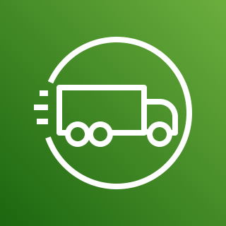



Storage
4/7
AWS Snowball Edge
AWS Snowmobile
AWS Snowball
AWS Snowcone
Snowball import-export

Slide 157




















Storage
5/7
AWS Backup
Backup plan
Backup vault
Virtual machine
Virtual machine monitor
AWS Backup Vault Lock
AWS Backup support for VMware workloads
AWS Backup for AWS CloudFormation
Recovery point objective
Recovery time objective
Database
Storage
Legal hold
AWS Backup support for Amazon S3
Compliance reporting
Backup restore
Gateway
Compute
AWS Backup Audit Manager
AWS Backup support for Amazon FSx for NetApp ONTAP

Slide 158





















Storage
6/7
Amazon Simple Storage Service (Amazon S3)
S3 Standard
S3 Intelligent- Tiering
S3 Standard-IA
S3 One Zone-IA
S3 Glacier Flexible Retrieval
S3 Glacier Deep Archive
S3 Glacier Instant Retrieval
S3 on Outposts
Bucket
Bucket with
objects
Replication
S3 Replication Time Control
S3 Storage Lens
Access points
VPC access points
Object
S3 Object Lambda
S3 Object Lambda Access Points
S3 Multi-Region Access Points
S3 Select
S3 Object Lock
S3 Batch Operations

Slide 159








Storage
7/7
Amazon S3 on Outposts
Amazon Simple Storage Service Glacier
Amazon File Cache
Vault
Archive
On-premises NFS linked datasets
Hybrid NFS linked datasets
S3 linked datasets

Slide 160

VR & AR
STANDARD CATEGORY ICON

Slide 161

VR & AR
1/1
Amazon Sumerian

